Slide 1

RAFALE
E-LEGAL MOCKUPS

Slide 2
Brief
Process Transition from Onshore to Offshore requires an arms length agreement between the two parties for legal purposes.
The current process is done manually with no common understanding of the process. Resulting in several incidents where appropriate validations and approvals were not taken before signing these contracts, which can have grave legal consequences.
The DCOE did a thorough study to understand the current process and user needs. These findings played an important role
In designing the product.
The solution is a digital platform which allows users to create agreements, seek necessary validations and approvals and document repository which allows users to access existing agreements.

Slide 4
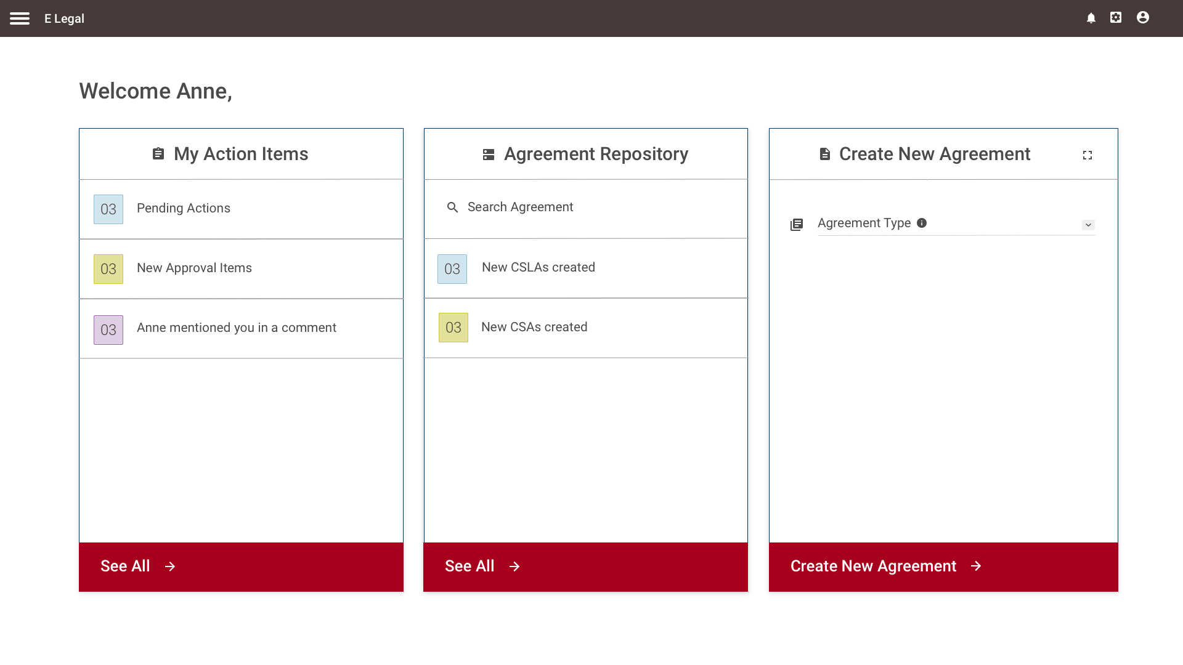
Dashboard

Slide 5
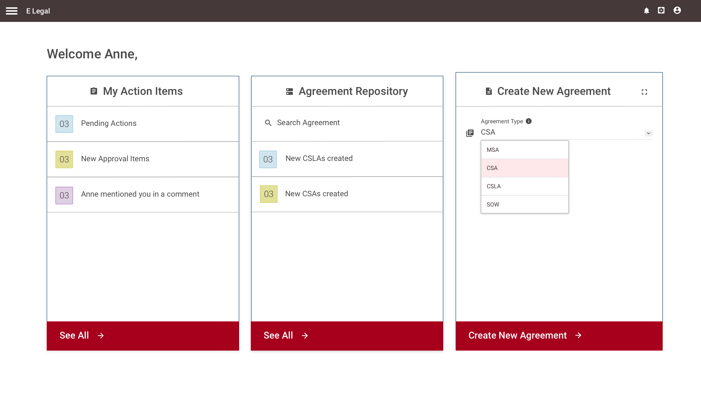
Create New Agreement

Slide 6
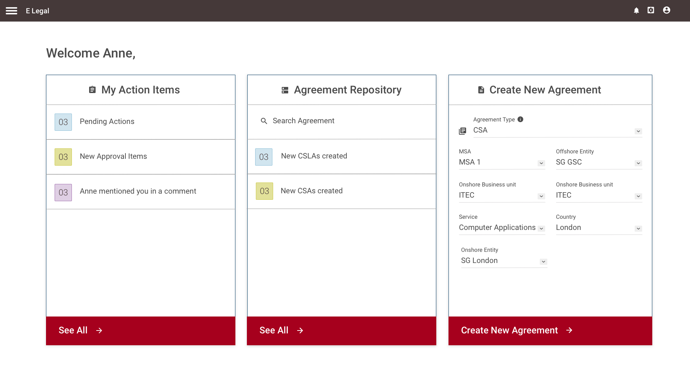
Specifying Agreement Details

Slide 7
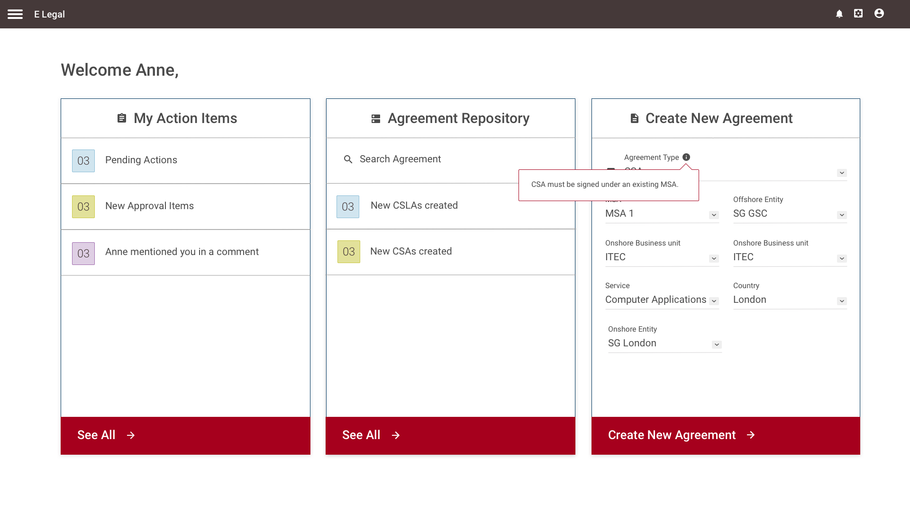
Specifying Agreement Details

Slide 8
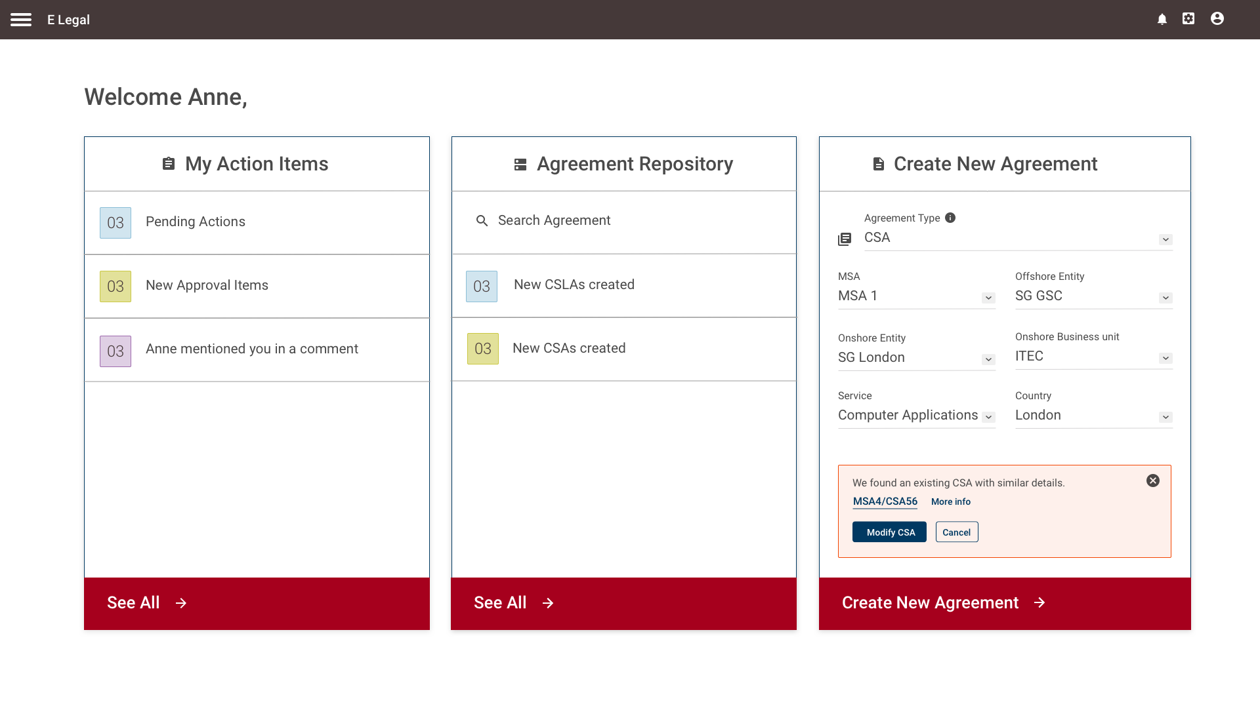
Notifications

Slide 9
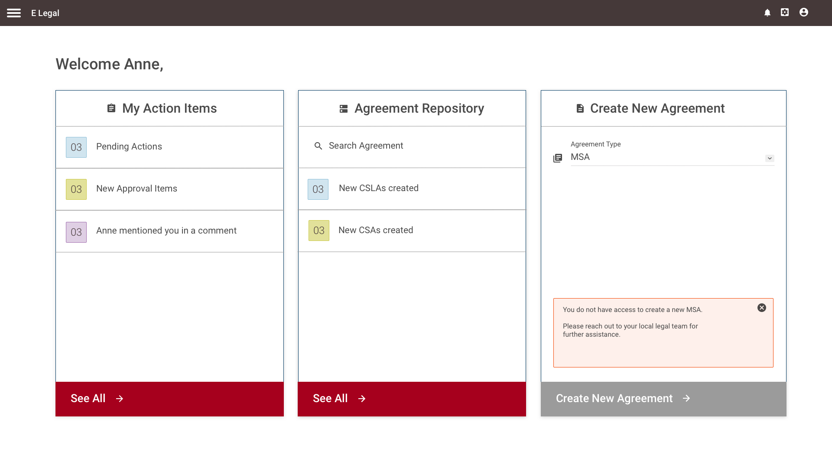
MSA Limitations

Slide 10
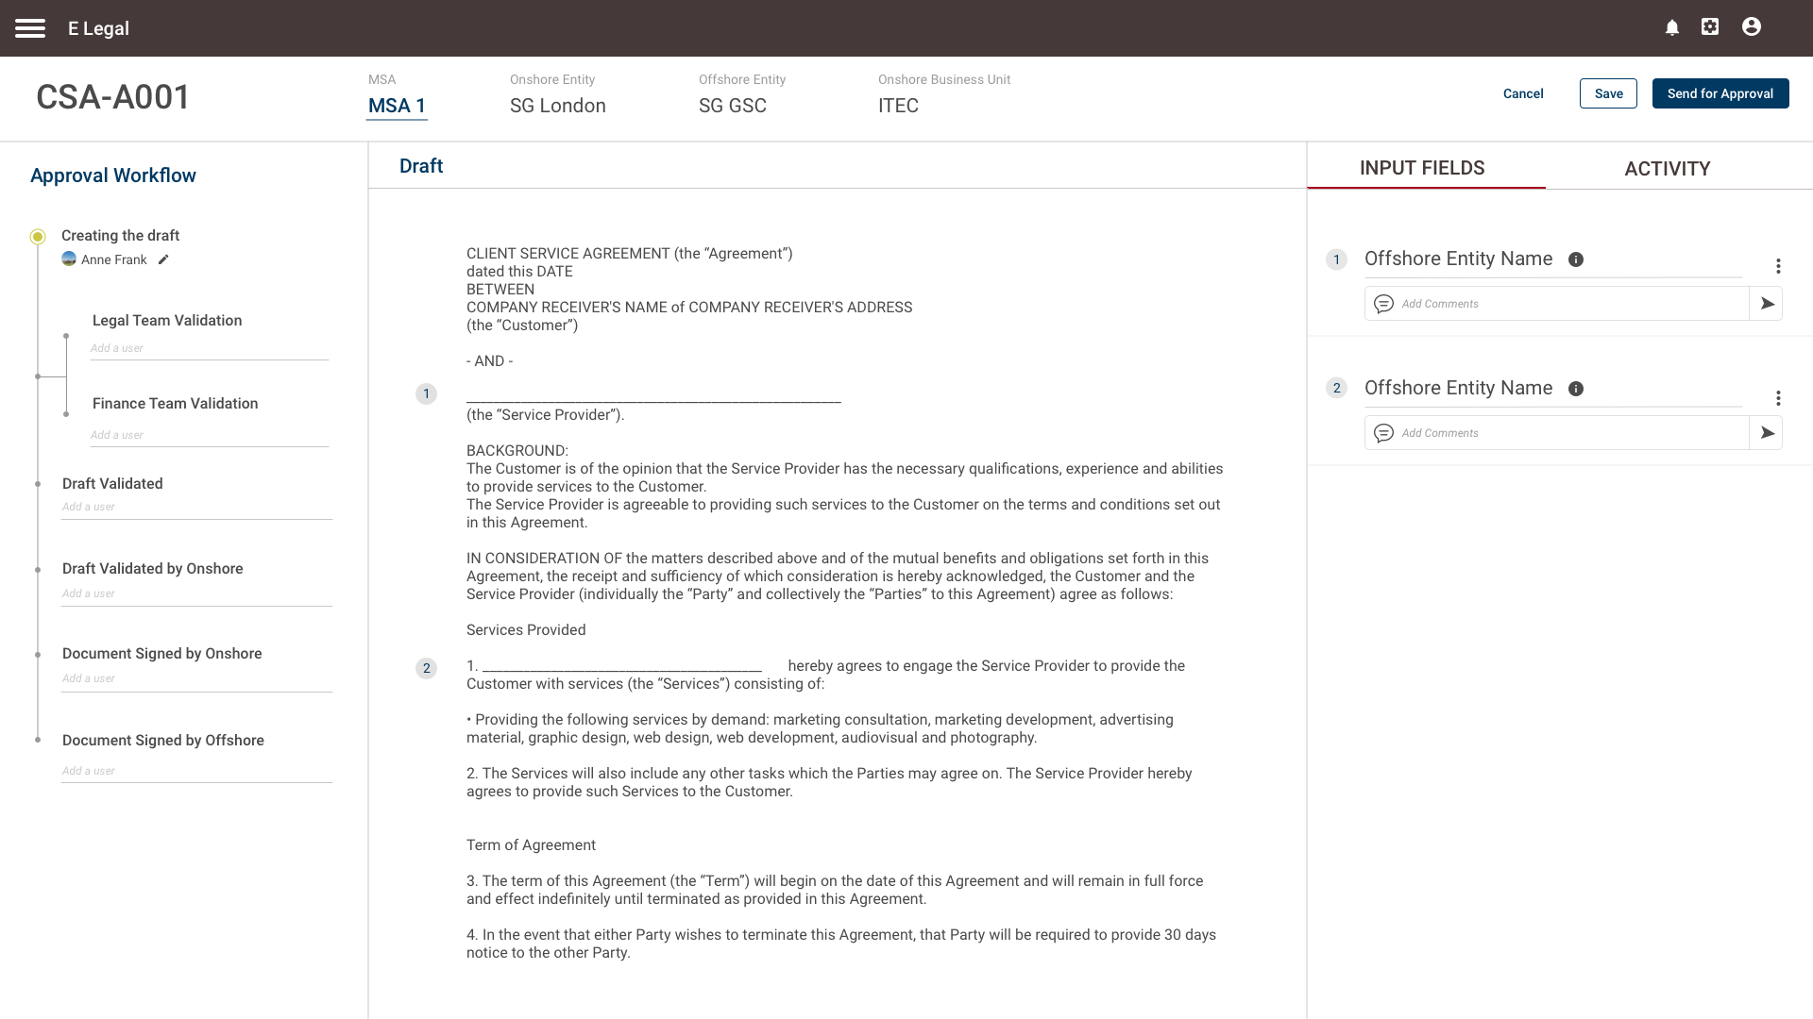
Draft View

Slide 11
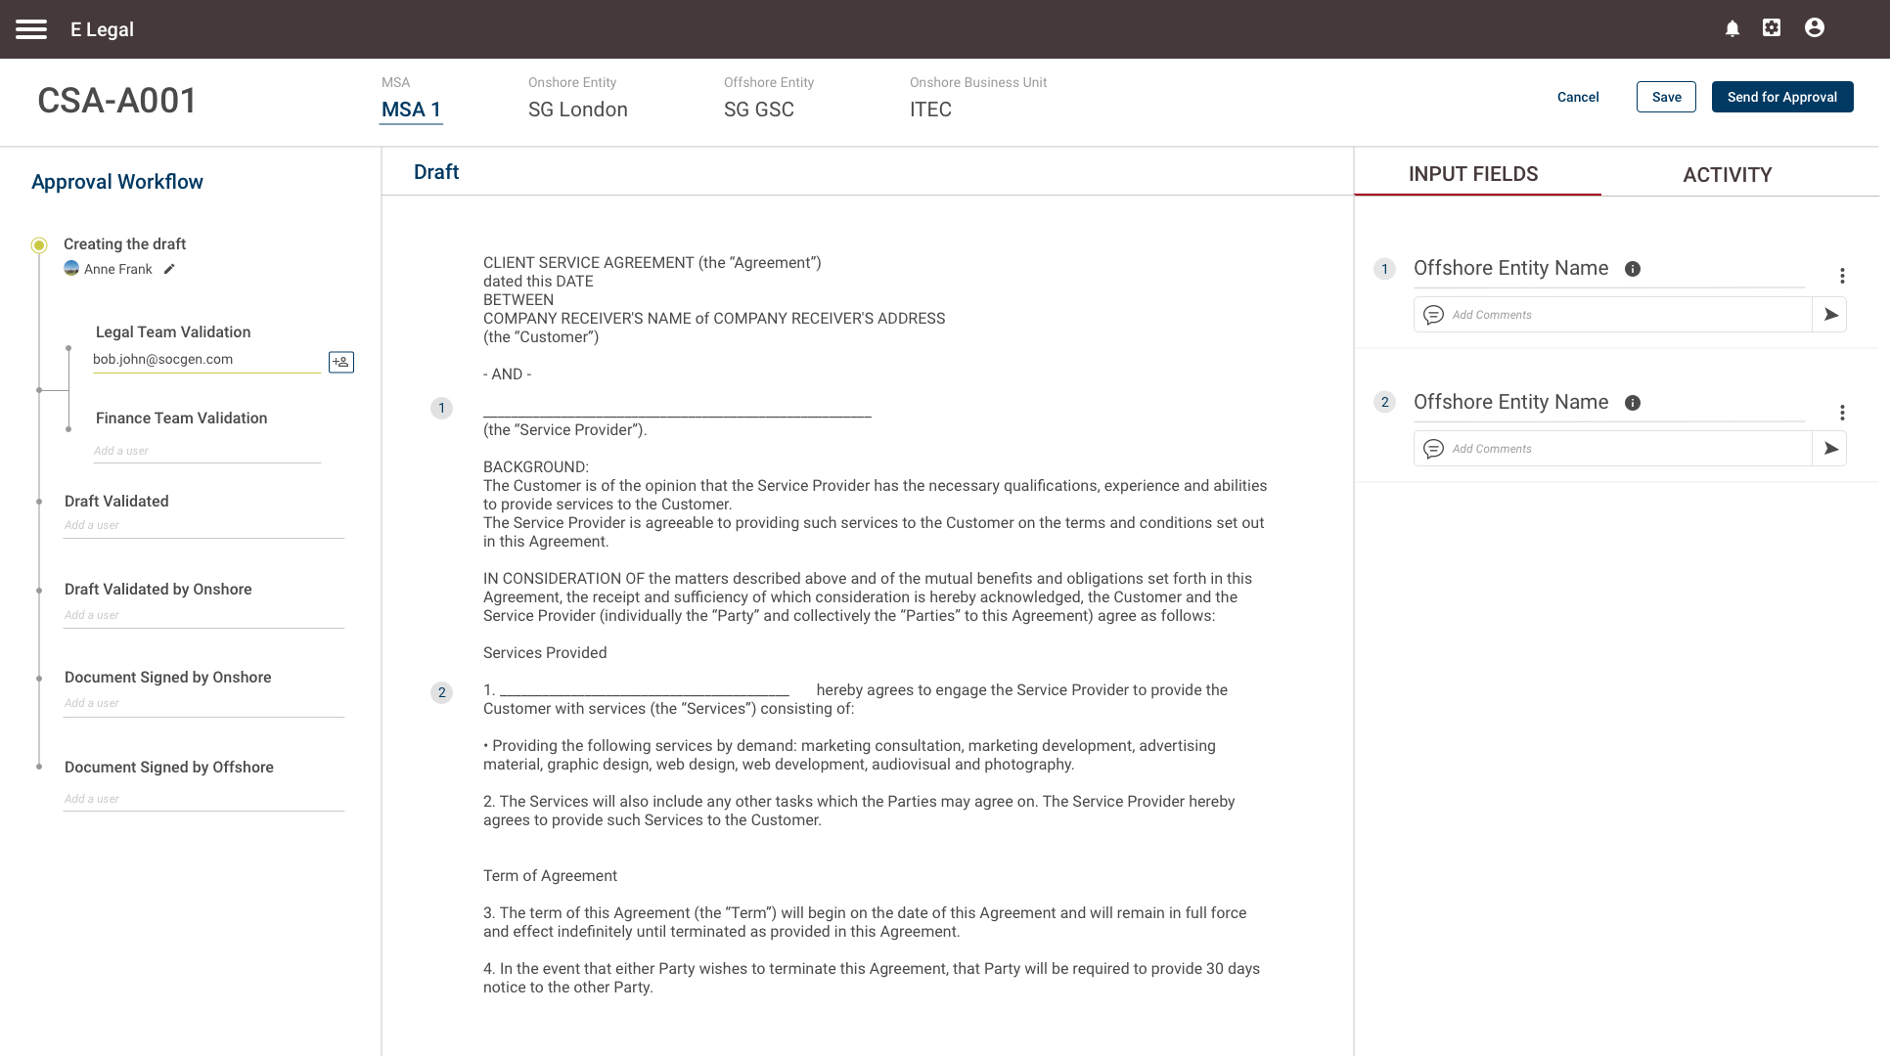
Adding Users to Workflow

Slide 12
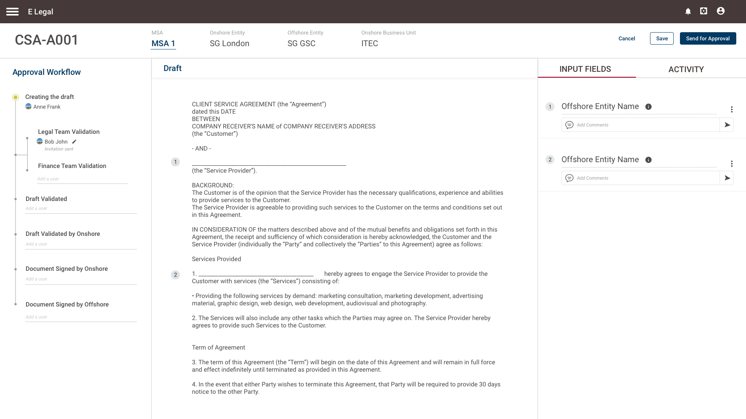
Adding Users to Workflow

Slide 13
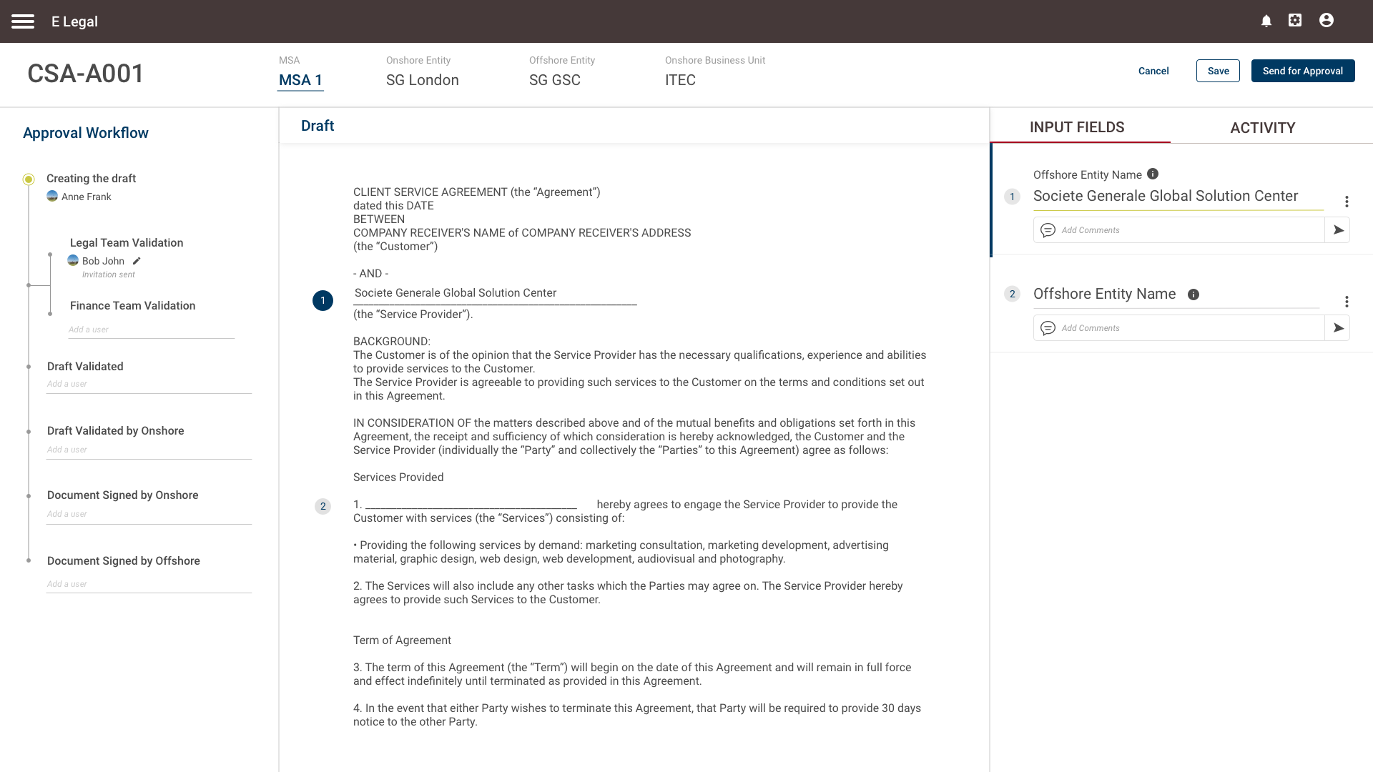
Input Fields

Slide 14
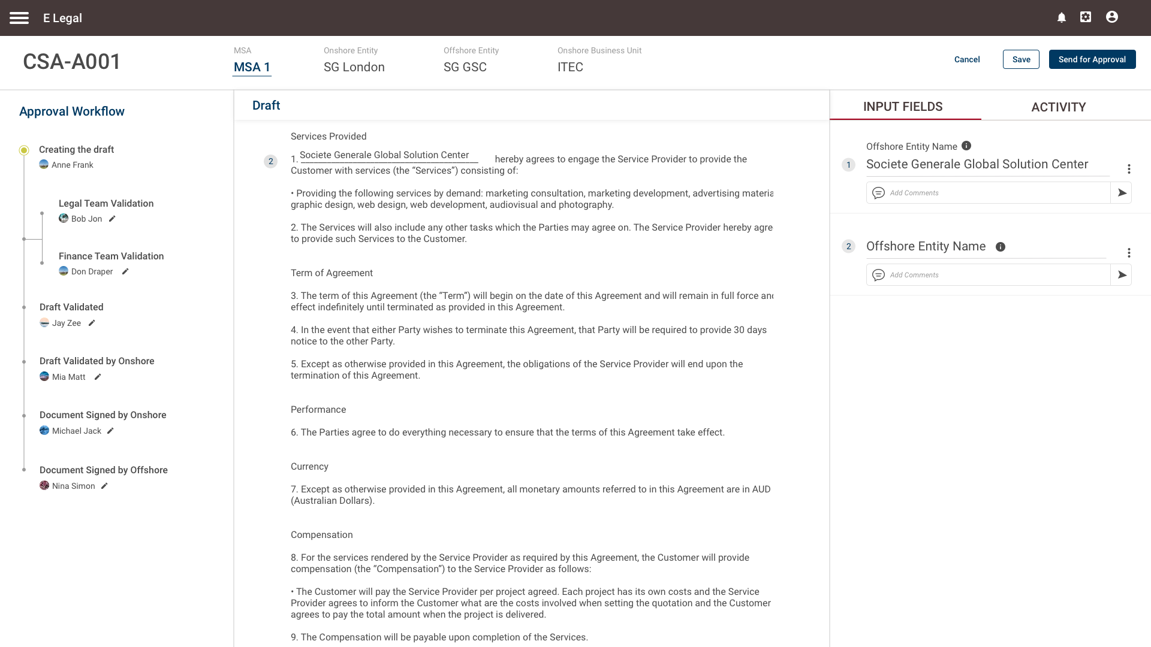
Input Fields

Slide 15
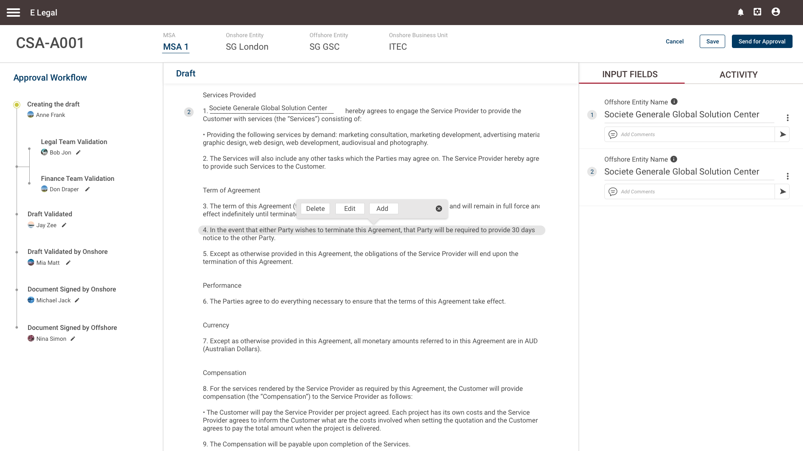
Editing Draft Text

Slide 16
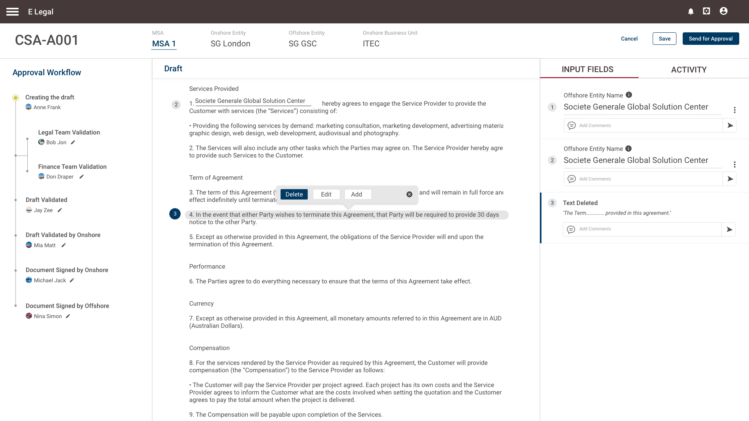
Editing Draft Text

Slide 17
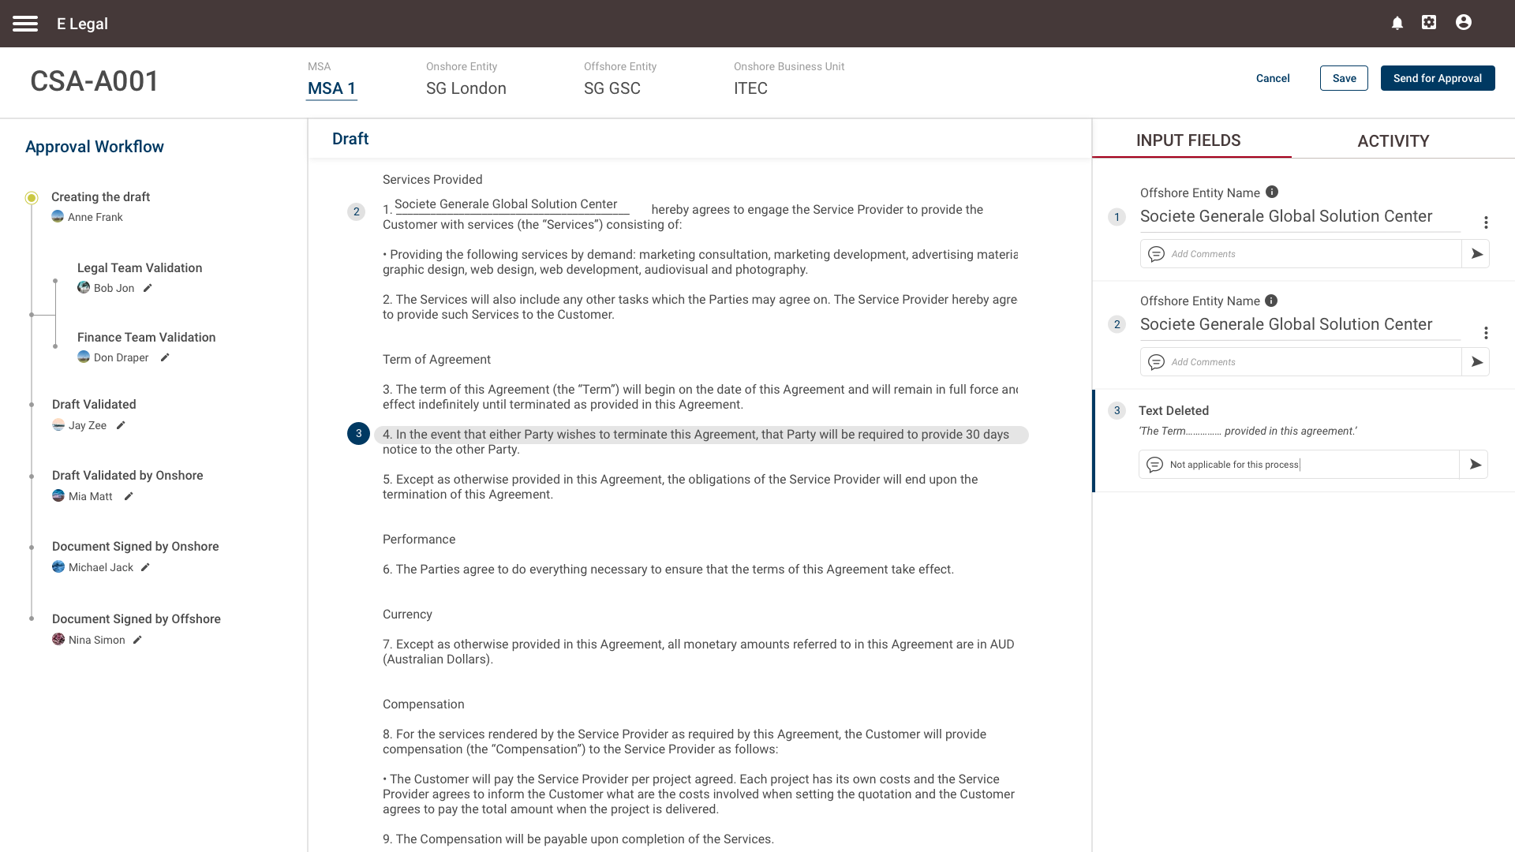
Adding Comment

Slide 18
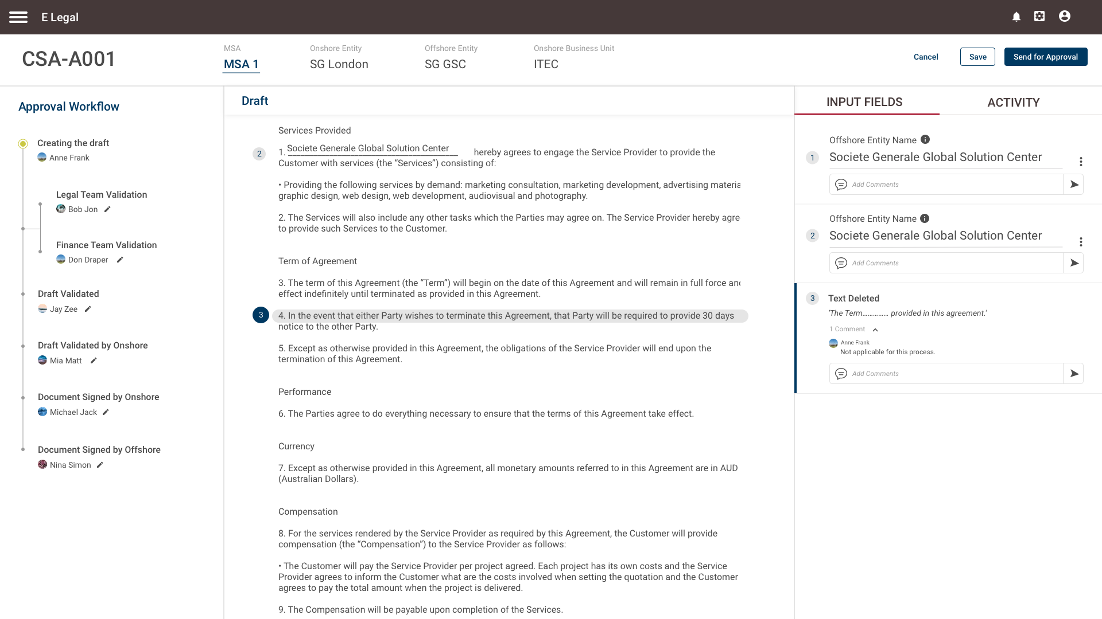
Adding Comment

Slide 19

Editing Draft Text

Slide 20
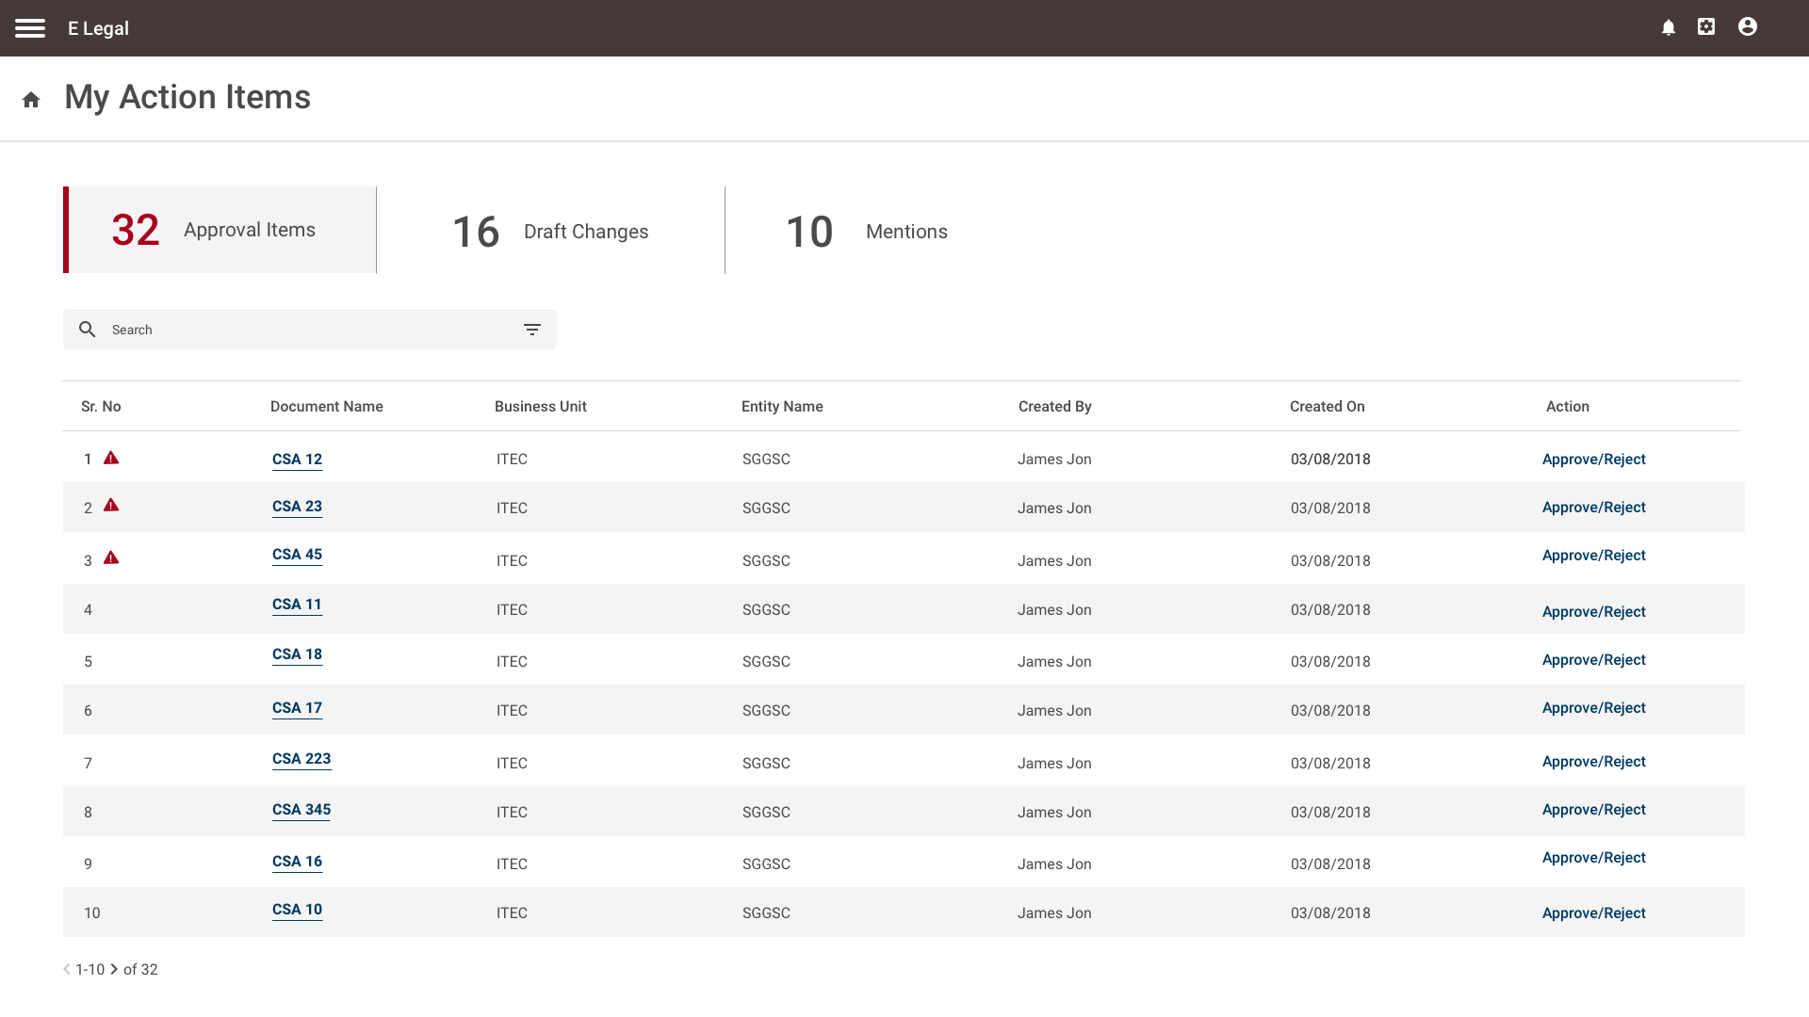
Action Items

Slide 21
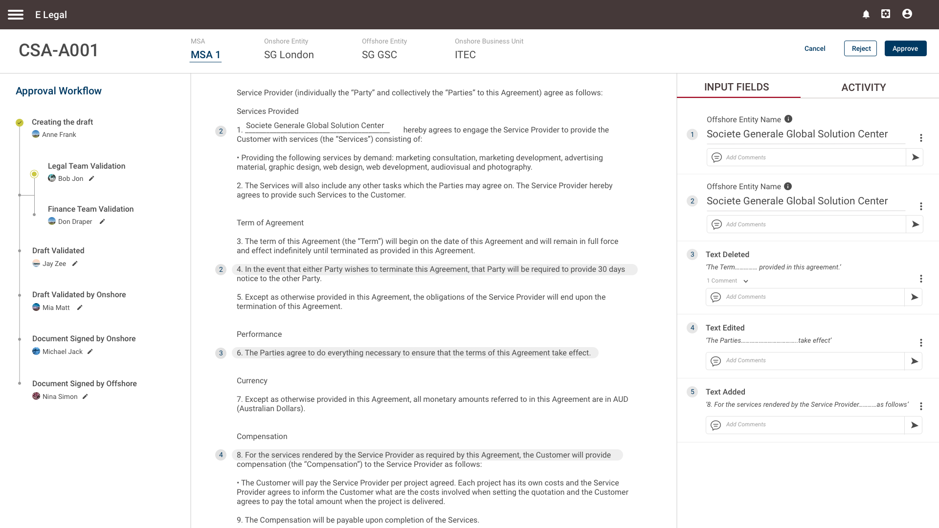
Action Items

Slide 22
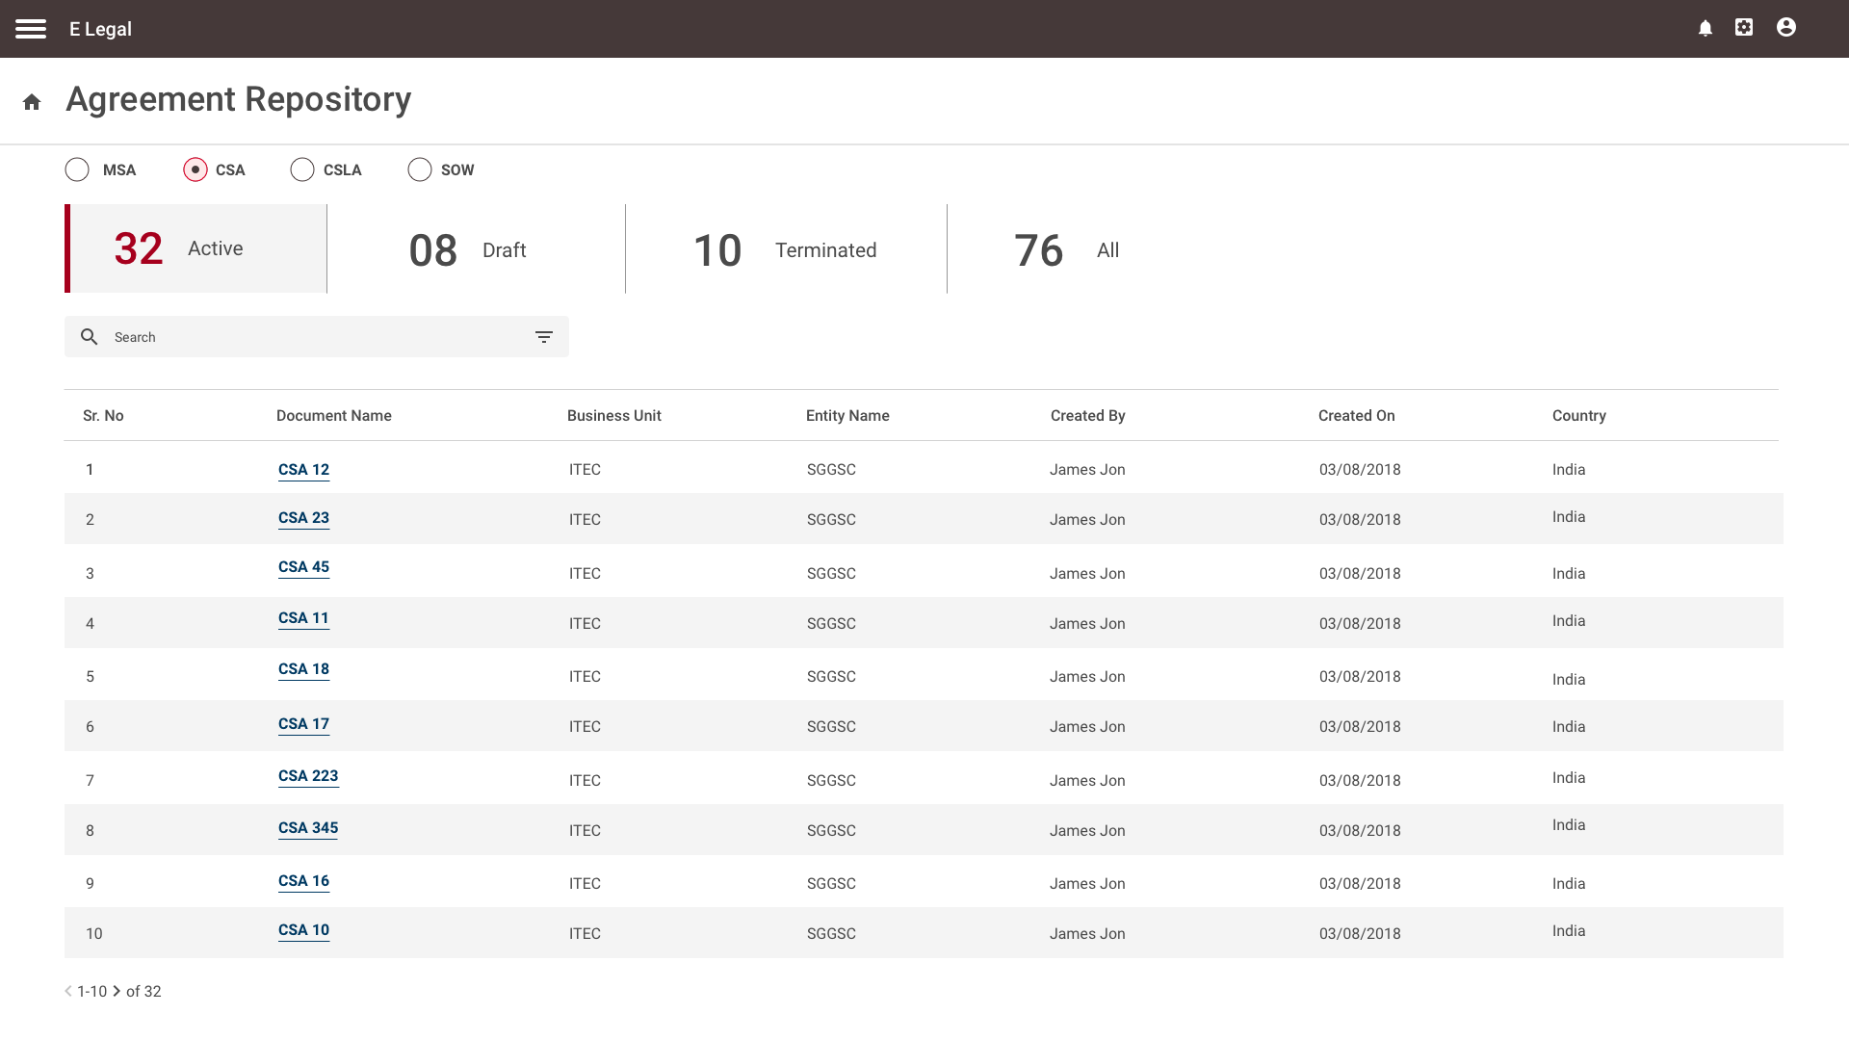
Agreement Repository

Slide 23
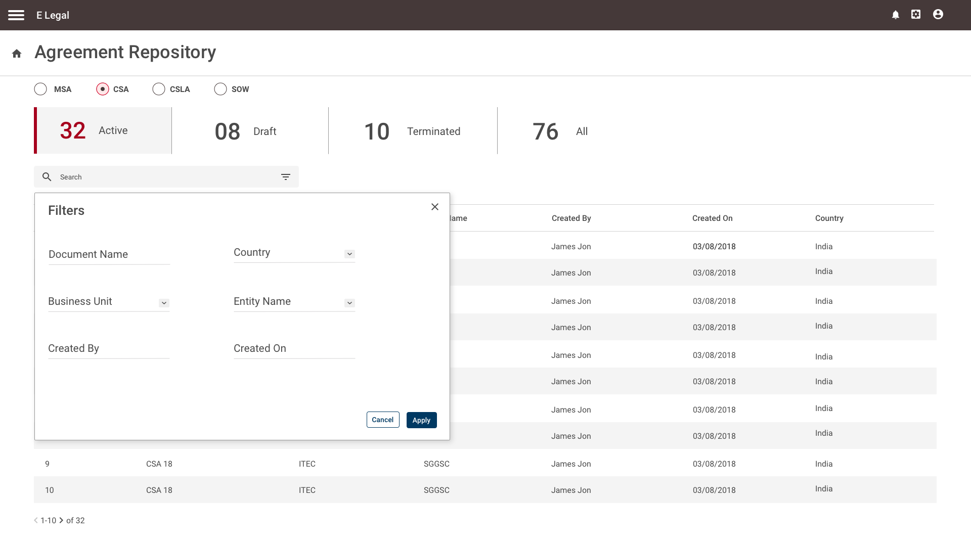
Search Filters

Slide 24

Search Filters

Slide 25
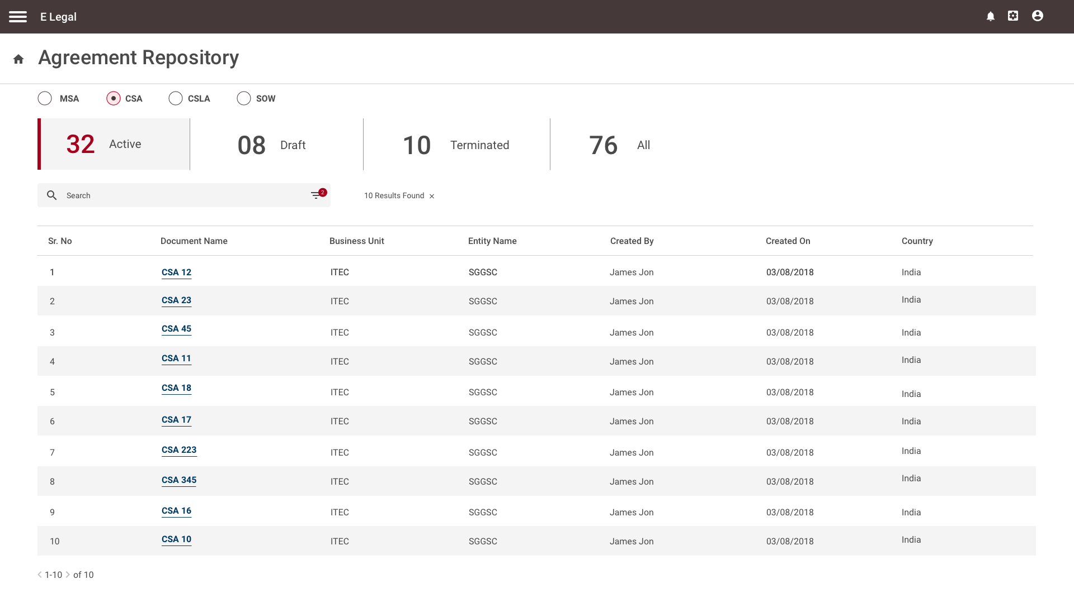
Search Filters

Slide 26
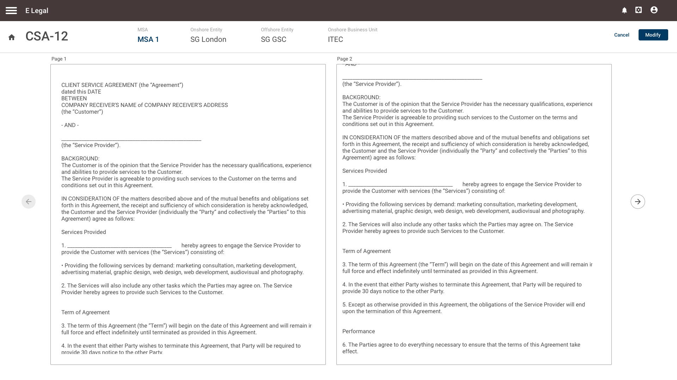
Agreement View

Slide 27
Thank you!

